Slide 1

Security+
Lesson 1
Authentication Methods

Slide 2

Lesson Objectives
Identify foundational security services and concepts
List basic authentication concepts (what you know, what you have, who you are)
Define authentication methods, including Kerberos, certificates, CHAP, mutual authentication, tokens, smart cards and biometrics
Identify the importance of multifactor authentication
Control authentication for modern operating systems

Slide 3
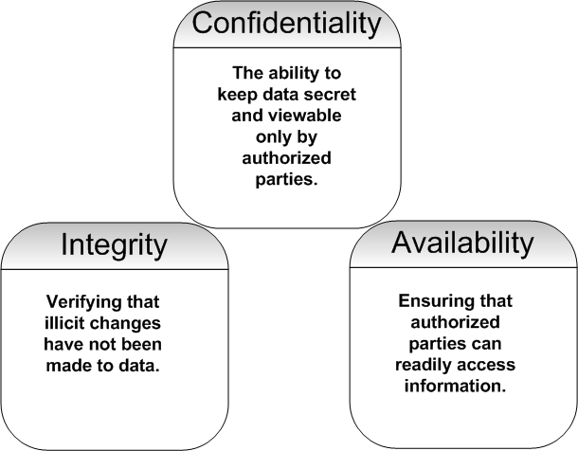
The CIA Triad

Slide 4
CIA and Non-Repudiation
Repudiation: an illicit attempt to deny sending or receiving a transaction. Examples of transactions include:
  A user sending an e-mail message to another user
  Web session in which a purchase is made
  A network host sending a series of port scans to a remote server
Non-repudiation: the ability to prove that a transaction has, in fact, occurred
Non-repudiation is made possible through signatures (digital and physical), as well as encryption and the logging of transactions

Slide 5

Additional Security Terms
Authentication
Authorization
Access control
Asset
Vulnerability
Threat
Threat Agent
Risk
Attack
Compromise
Counter-measure
Malicious user
Exploit
Authentication information

Slide 6
Security+ Exam:
Authentication, Access Control and Auditing
The Security+ exam focuses on the following concepts:
  Authentication
  Access control
  Auditing access to systems

Slide 7
Security and Business Concerns
Security is a business concern: In most cases the business’s most important asset is the information it organizes, stores and transmits
Foundational security documents
  Trusted Computer Systems Evaluation Criteria (TCSEC)
  ISO 7498-2
  ISO 17799
  Health Insurance Portability and Accountability Act (HIPAA)

Slide 8
Authentication
Authentication credentials can include:
  A user name and password
  Tokens, such as those created by token cards
  Digital certificates
Summarizing the logon process
  Identification
  Authentication
  Authorization
  Access

Slide 9
Authentication Methods
Proving what you know
Showing what you have
Demonstrating who you are
Identifying where you are

Slide 10
Authentication Tools and Methods
Mutual authentication
Single sign-on authentication
User name and password
Kerberos
Certificates
Tokens
One-time passwords
Challenge-Handshake Authentication Protocol (CHAP)
Smart cards
Biometrics

Slide 11
Authentication Tools and Session Keys
Session keys are generated using a logical program called a random number generator, and they are used only once
A session key is a near-universal method used during many authentication processes

Slide 12
Multifactor Authentication
Security and multifactor authentication
Complexity and multifactor authentication

Slide 13
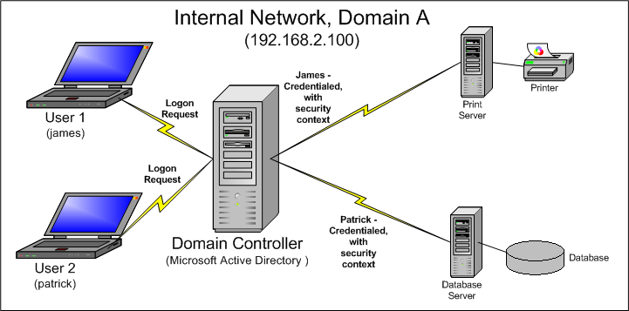
Single Sign-on Authentication
A single system (can be a set of servers) holds authentication information
When a user, host or process has a credential, it is said to have a security context

Slide 14
Single Sign-on Authentication (cont’d)
Examples of single sign-on technologies
  Novell Directory Services
  Microsoft 2003 Server Active Directory
  Microsoft Passport
  Massachusetts Institute of Technology
Single sign-on and delegation
Drawbacks and benefits of single sign-on technology

Slide 15
Mutual Authentication
Both the client and the server authenticate with each other, usually through a third party
Mutual authentication goals
Examples of mutual authentication
  Kerberos
  Digital certificates
  IPsec
  Challenge Handshake Authentication Protocol (CHAP)
Simple and complex mutual authentication

Slide 16
User Name and Password
The most traditional and common form of authentication (probably the most common)
Account protection
  Password length
  Password complexity
  Password aging
Enforcing strong passwords
  Windows 2003 Server
  Linux
Applying user name and password-based authentication: Windows and Linux
  Password uniqueness
  Reset at failed logon
  Account lockout

Slide 17
Authentication in Windows and Linux
Linux
  Root account
  Security and the root account
  Shadow passwords
  The /etc/passwd, /etc/group, and /etc/shadow files
  Pluggable Authentication Modules (PAM)
Windows
  Five default registry keys:
  HKEY_CLASSES_ROOT, HKEY_LOCAL_MACHINE, HKEY_USERS, HKEY_CURRENT_USER, HKEY_CURRENT_CONFIG
  Security Accounts Manager (SAM)

Slide 18
Understanding Kerberos
A method for storing keys in a centralized repository
Kerberos versions
  Version 4
  Version 5
  Microsoft
Kerberos components
  Key Distribution Center (KDC)
  Principal
  Authentication Service (AS)
  Ticket Granting Service (TGS)
  Ticket Granting Ticket (TGT)
  Resource
  Trust relationship
  Repository
  Realm
  Ticket

Slide 19
Understanding Kerberos (cont’d)
Additional Kerberos elements
Kerberos realms and DNS
Kerberos principals
  Principal name
  Optional instance
  Kerberos realm

Slide 20
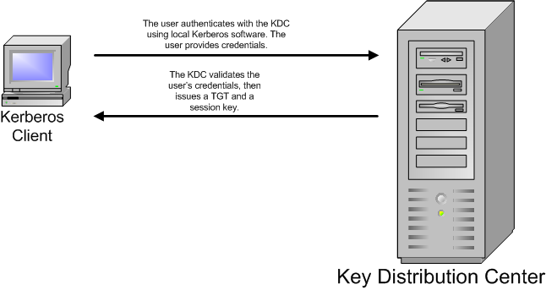
Understanding Kerberos (cont’d)
Obtaining a TGT

Slide 21
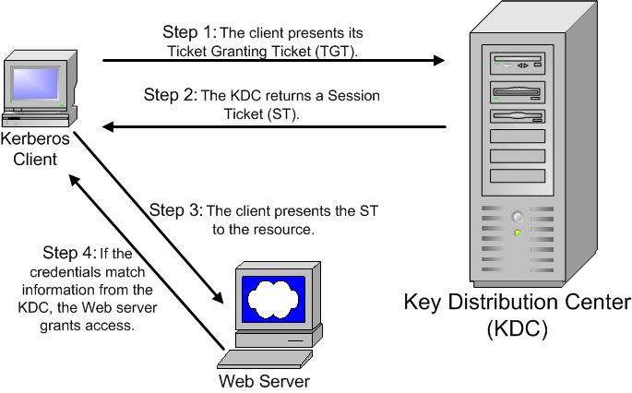
Understanding Kerberos (cont’d)
Client authentication via Kerberos

Slide 22
Understanding Kerberos (cont’d)
Kerberos and the Network Time Protocol (NTP)
Kerberos strengths and weaknesses
Ports used in Kerberos
Directory-based communication
Kerberos and interoperability
Delegation and Kerberos

Slide 23
Certificates
A certificate (i.e., digital certificate) acts as a trusted third party to allow unknown parties to authenticate with each other
Issued by a Certificate Authority (CA)
Digital certificates used in modern systems conform to the ITU X.509 standard
Certificate types
Establishing trust

Slide 24
Token-Based Authentication
A form of multifactor authentication
Two methods of token-based authentication
  Hardware (for example, token card)
  Software
Strengths and weaknesses
  Token-card-based authentication combines something-you-have authentication with something-you-know authentication—consequently, it provides more security
  Inconvenience and still password-based
One-time passwords
  Common implementations
  Strengths and weaknesses

Slide 25
Challenge Handshake
Authentication Protocol (CHAP)
The secret is shared between two systems, but is never sent across the network wire
CHAP requirements
The CHAP handshake
Strengths and weaknesses

Slide 26
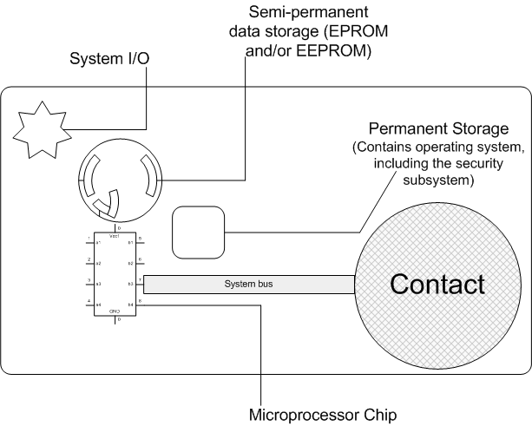
Smart Cards
Smart card components
Types of smart cards

Slide 27
Smart Cards (cont’d)
Smart card uses
Smart cards and infrastructure security
Smart card benefits and drawbacks

Slide 28
Biometrics
Biometric-based authentication uses a person's physical characteristics as a basis for identification
Strategies
  Fingerprints
  Hand geometry
  Voice recognition
  Retinal scans
Biometric implementations and standards
Benefits and drawbacks
  Iris scans
  Face recognition
  Vascular patterns

Slide 29
Extensible Authentication Protocol (EAP)
Allows multifactor authentication over Point-to-Point-Protocol and wireless links
Capable of supporting authentication by way of various methods, including:
  RADIUS
  CHAP
  Token cards
  Digital certificates, using EAP-tunneled TLS (EAP-TLS)
  A Kerberos server

Slide 30
Security+
Lesson 2
Access Control

Slide 31
Lesson Objectives
Define common access control terminology and concepts
Define Mandatory Access Control (MAC)
Implement Discretionary Access Control (DAC)
Define Role-Based Access Control (RBAC)
Identify operating systems that use MAC, DAC and RBAC
Follow an audit trail

Slide 32
Access Control Terminology and Concepts
Access control is the use of hardware-based and software-based controls to protect company resources
Access control can take at least three forms
  Physical access control
  Network access control
  Operating system access control
Three essential terms for the Security+ exam
  Identification: occurs first; user presents credentials
  Authentication: the operating system checks credentials
  Authorization: the operating system recognizes the user
Subjects, objects and operations
Additional access control terms

Slide 33
The Audit Trail: Auditing and Logging
All secure, modern network operating systems have a dedicated auditing service, which is responsible solely for documenting system activities (the “audit trail”)
Activities, or events, include successful and failed logons, clearing of log files, and resource modification
The auditing system should remain isolated
Audit trails and physical resources
Operating systems and the audit trail
  Windows-based events and issues
  Linux events and issues
Filtering logs
Audit trails, remote logging and hard copy backups
The reference monitor and system elements

Slide 34
Access Control Methods
The three major access control methods
  Discretionary Access Control (DAC)
  Mandatory Access Control (MAC)
  Role-Based Access Control (RBAC)
You must understand the details of each of these models, as well as how they relate to operating systems that you may already administer

Slide 35
Discretionary Access Control (DAC)
Users control access to resources (in other words, objects) they own
Essential concepts
  Ownership
  Permissions
  Access control list (ACL)
  Capabilities
DAC-based systems and access control lists
Default policies
Common permissions and inheritance
DAC-based operating systems and ownership
DAC strengths and weaknesses

Slide 36
Mandatory Access Control (MAC)
Systems that use Mandatory Access Control (MAC) are not based on user ownership of resources; ownership is controlled by the operating system, not the individual user
Three essential MAC principles
  Access policy
  Label
  Access level
Understanding access levels
Types of MAC, and overview of MAC-based systems
Data import and export
MAC-based operating systems
MAC advantages and drawbacks

Slide 37
Role-Based Access Control (RBAC)
Operating systems and services that use Role-Based Access Control (RBAC) manage users and services based on the function of that user or service in a particular organization
Based on MAC
RBAC and the health-care industry
Operating systems, services and RBAC
Preparing for RBAC
Role hierarchies
RBAC benefits and drawbacks

Slide 38
Balancing Responsibilities of Security
When you determine access control for resources, your responsibility as a security professional is to manage the following
  Availability requirements
  Security requirements
Ways to meet the challenge of achieving balance include:
  Planning security implementations from the top down
  Training end users, as well as security and IT workers, regarding the access control model used in your company

Slide 39
Security+
Lesson 3
Cryptography Essentials

Slide 40
Lesson Objectives
Identify basic cryptography concepts
Implement public-key encryption
Define symmetric-key encryption
List hashing algorithms
Identify ways that cryptography helps data confidentiality, data integrity and access control
Identify the importance of cryptography to non-repudiation and authentication
Use digital signatures
Define the purpose of S/MIME

Slide 41
Cryptography and Encryption
In practical terms, cryptography is the study of using mathematical formulas (often called problems) to make information secret
The word cryptography is based on the Greek words "krypt" (secret) and "graph" (writing)
  Encryption, a subset of cryptography, is the ability to scramble data so that only authorized people can
  unscramble it
Common cryptography terms

Slide 42
Cryptography and Encryption (cont’d)
Types of encryption algorithms
  Symmetric key
  Asymmetric key
  Hashing
Services provided by encryption
  Data confidentiality
  Data integrity
  Authentication
  Non-repudiation
  Access control
Establishing a trust relationship

Slide 43
Hash Encryption
The use of an algorithm that converts information into a fixed, scrambled bit of code
Uses for hash encryption
Specific hash algorithms used in the industry
  Message digest (a family of hash algorithms)
  HAVAL
  RIPEMD
  Secure Hash Algorithm (SHA)
Collisions and salt

Slide 44
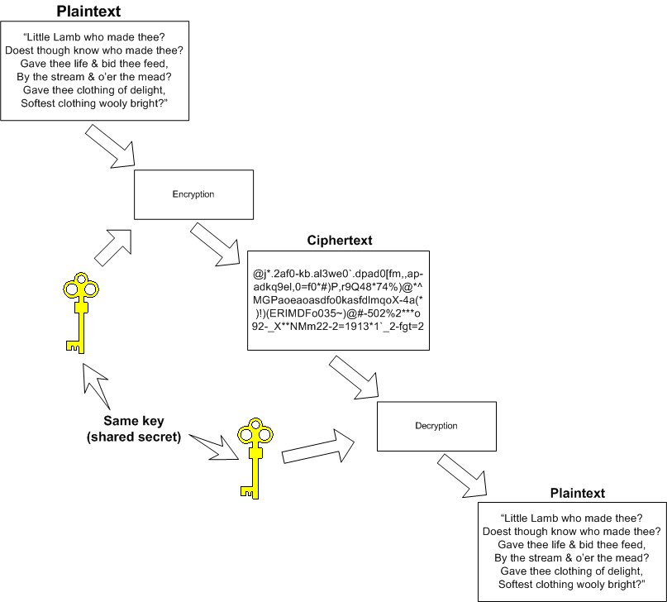
Symmetric-Key Encryption
One key both encrypts and decrypts information

Slide 45
Symmetric-Key Encryption (cont’d)
Symmetric-key encryption uses rounds to encrypt data; each round further encrypts data
Benefits
  Fast: usually even large amounts of data can be encrypted in a second
  Strong: usually sufficient encryption achieved in a few rounds; using more rounds consumes more time and processing power
Drawbacks
  Reaching a level of trust
  First-time transmission of the key is the classic problem

Slide 46
Block and Stream Ciphers
Block ciphers: Data is encrypted in discrete blocks (usually 64 bits in size). A section of plaintext of a certain length is read, and then it is encrypted. Resulting ciphertext always has the same length as the plaintext.
Stream ciphers: Data is encrypted in a continual stream, one bit at a time, similar to the way data passes in and out of a networked computer.
  Most commonly used in networking
  Strategies for ensuring randomness: pseudo-random number generators and initialization vectors

Slide 47
One-Time Pads
A specific application of a stream cipher
Considered highly secure (many references feel OTPs are unbreakable)
Drawbacks
  Reliant on a secure transmission channel
  Generating sufficiently random data can drain resources

Slide 48
Symmetric-Key Cipher Types
Cipher types include the following
Type
Description
Substitution
Plaintext is converted into ciphertext by replacing the binary representations of certain characters with others. In a similar example, Julius Caesar developed a wheel (called Caesar's wheel) that substituted letters of the alphabet for others.
Transport-
ation
Ciphertext is created by moving data from one part of a message block, rather than simply substituting it. Uses complex mathematical problems that allow data to be radically changed.
Processing binary data for encryption
XOR process

Slide 49
Symmetric Algorithms
Data Encryption Standard (DES)
  Phases of DES encryption
  Modes of DES
  DES advantages and drawbacks
Triple DES and other DES variants
Symmetric-key algorithms created by the RSA Corporation, including RC2, RC4, RC5 and RC6
IDEA
Blowfish
Skipjack
MARS
ISAAC

Slide 50
Symmetric Algorithms (cont’d)
Serpent
CAST
Rijndael
Advanced Encryption Standard (AES)
  Many candidates
  Rijndael chosen
Additional symmetric algorithms

Slide 51
Strengthening Symmetric-Key Encryption
The most effective ways to strengthen symmetric-key encryption
  Provide for additional encryption rounds
  Increase the length of the key
  Change keys regularly
  Do not send the key across a network connection
Examples of symmetric-key encryption

Slide 52
Asymmetric-Key Encryption
Uses a key pair in the encryption process rather than the single key used in symmetric-key encryption
A key pair is a mathematically matched key set in which one half of the pair encrypts and the other half decrypts
  What A encrypts, B decrypts; what B encrypts, A decrypts
  The two keys in the pair are, in effect, two sides of the same coin

Slide 53
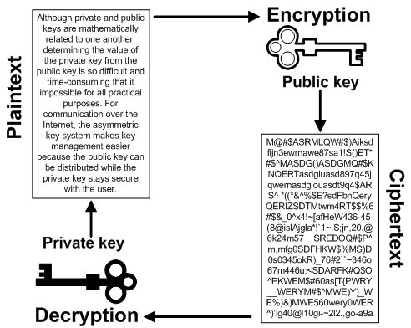
Asymmetric-Key Encryption (cont’d)
One of the keys in the pair is made public, and the other is kept private. If you encrypt to a public key, only the related private key can decrypt it.

Slide 54
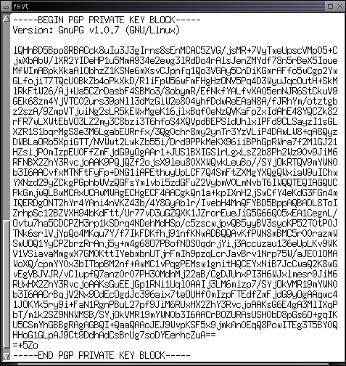
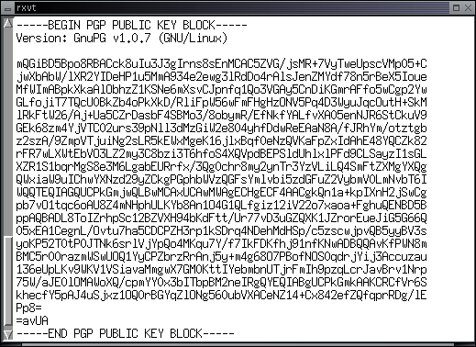
Examples of Asymmetric-Key Encryption
Although the key pair is related, it is difficult (if not impossible) to derive the value of the private key from the public key

Slide 55
Sending Messages
When using asymmetric-key encryption to send a secret to X, encrypt the secret with X's public key, then send the encrypted text
When X receives the encrypted text, X will decrypt it with a private key
Anyone who intercepts the encrypted text cannot decrypt it without X's private key—this is true even if he or she has X’s public key

Slide 56
Asymmetric-Key Encryption and SSL/TLS
Whenever a Web browser uses SSL/TLS, it is using asymmetric-key encryption
SSL/TLS and LDAP
Asymmetric-key encryption and data confidentiality
Asymmetric-key encryption and data integrity
Asymmetric-key encryption and non-repudiation

Slide 57
Elements Used in Asymmetric-Key Encryption
Elements that can be used in asymmetric-key encryption
  Diffie-Hellman
  RSA
  El Gamal
  DSA
  Elliptic Curve Cryptography (ECC)
Benefits
  Secure key exchange
  Data can be encrypted strongly
Drawbacks
  Slow, processor-intensive encryption
  Usually, asymmetric-key encryption is used to encrypt small amounts of data, such as symmetric keys (which are in turn used to encrypt large amounts of data, such as e-mail messages and attachments)

Slide 58
Applied Encryption
Digital signature: a unique identifier that authenticates a message, as would a standard, written signature
  A digital signature combines a private key generated by an asymmetric-key algorithm (e.g., RSA or DSA) and hash encryption (e.g., SHA-1 or MD5)
Services provided by digital signatures
  Authentication
  Non-repudiation
  Data integrity
  Digital signatures do not provide data confidentiality
Creating a digital signature

Slide 59
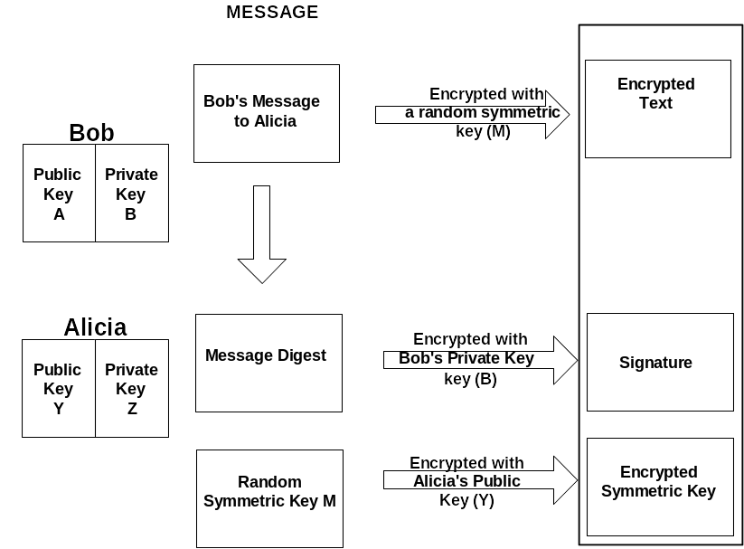
Applied Encryption (cont’d)
Using PGP/GPG to encrypt e-mail messages

Slide 60
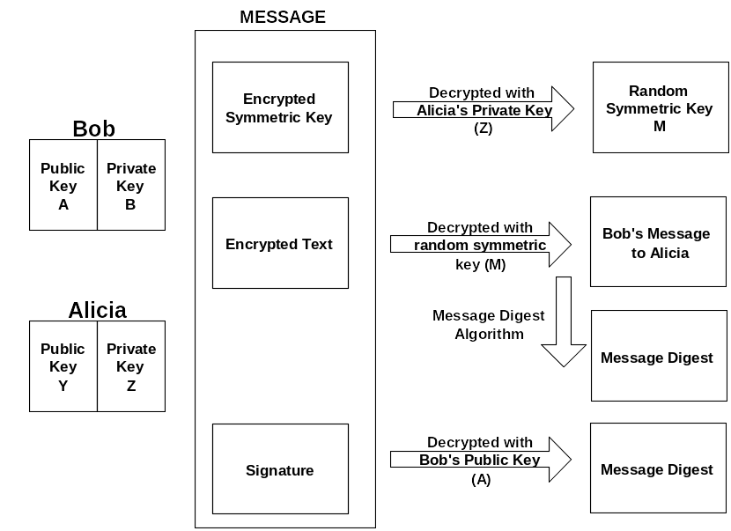
Applied Encryption (cont’d)
Decrypting
e-mail messages

Slide 61
Applied Encryption (cont’d)
Multipurpose Internet Mail Extensions (MIME) and Secure MIME (S/MIME)
Encrypting network transmissions
Message Authentication Code (MAC)
Message Authentication Code (HMAC)
Creating a Security Matrix
Encryption limitations
Access control and encryption

Slide 62
Security+
Lesson 4
Public Key Infrastructure

Slide 63
Lesson Objectives
Define Public Key Infrastructure (PKI), including standard, protocols, certificate policies and practice statements
Identify certificate authority (CA) trust models
Define the certificate life cycle, including key escrow, expiration, revocation, recovery and renewal
Store keys
Identify benefits of multiple key pairs

Slide 64
Public Key Infrastructure (PKI) Essentials
A Public Key Infrastructure (PKI) is a collection of individuals, networks and machines that together have the ability to authoritatively confirm the identity of a person, host or organization
Can be used for many purposes, from SSL/TLS to IPsec and S/MIME
Common PKI terms
Creating a CA
  Types of certificates
  Choosing certificate types
Using a certificate

Slide 65
Public Key Infrastructure (PKI)
Essentials (cont’d)
PKI standards and protocols
  Public-Key Cryptography Standards (PKCS)
  Distinguished Encoding Rules (DER ) and BASE64 encoding
  Institute of Electrical and Electronics Engineers (IEEE) 1363 standard

Slide 66
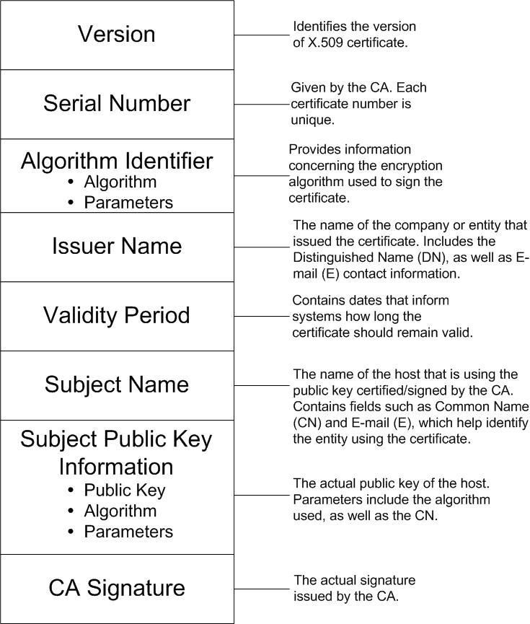
Public Key Infrastructure (PKI)
Essentials (cont’d)
X.509:
The
digital
certificate
format

Slide 67
Public Key Infrastructure (PKI)
Essentials (cont’d)
The X.509 v2 and v3 standards add the following fields
  Issuer unique identifier
  Subject unique identifier
  Extensions (v3)
Common X.509 field codes (e.g., S, E and CN)
Certificate concerns
PKIX

Slide 68
Public Key Infrastructure (PKI)
Essentials (cont’d)
Certificate policies
  Determines how employees in an organization should use certificates
  A public, unencrypted document that should be posted as a reference document
Certificate Practice Statement (CPS)
  Explains exactly how a CA verifies and manages certificates
  A process document
  Describes how authentication information is verified and how certificates will be generated

Slide 69
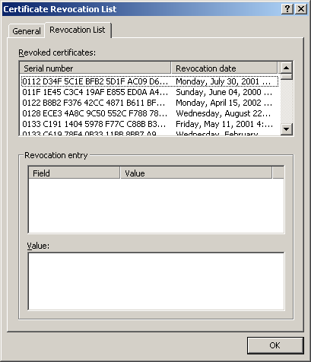
Public Key Infrastructure (PKI)
Essentials (cont’d)
Certificate revocation
  Certificate
  Revocation
  List (CRL)

Slide 70
Public Key Infrastructure (PKI)
Essentials (cont’d)
CRLs versus the Online Certificate Status Protocol (OCSP)
  OCSP is a client-server protocol that allows you to obtain certificate revocation information more selectively
  Instead of downloading a list, you can query a server for a particular certificate name

Slide 71
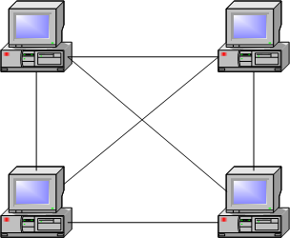
Common Trust Models
Web of trust

Slide 72
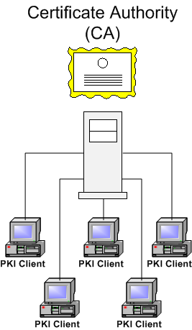
Common Trust Models (cont’d)
Single CA trust

Slide 73
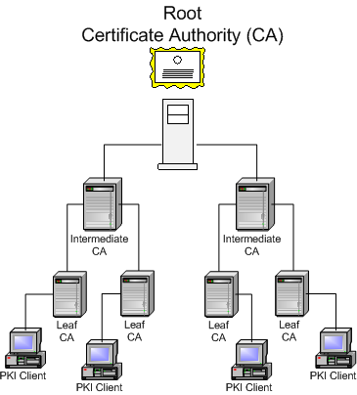
Common Trust Models (cont’d)
Hierarchical trust

Slide 74
Common Trust Models (cont’d)
Benefits and drawbacks
Transitory and non-transitory trust

Slide 75
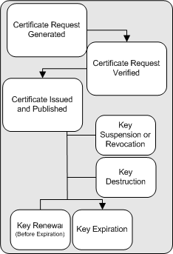
Key Management and the Certificate Life Cycle
Elements of the
key life cycle

Slide 76
Key Expiration
Whenever a key is created, it has a specific beginning and ending date
As a key reaches the specified ending date, it expires
The primary reason for having a key expire is to thwart repeated password-guessing attacks
Standard practice is to make certificates expire in periods such as one, two or even five years

Slide 77
Key and Certificate Revocation
Revocation occurs when a key is deemed no longer valid before its expiration date
Key revocation occurs after a given period of time, and is expected
Status checking for keys
  Many times, the CA will automatically contact a PKI client with a reminder that the certificate is about to expire
  This warning gives the client time to renew the certificate and continue working
  Usually, you must read the CRL, or use OCSP

Slide 78
Key Suspension
A key does not necessarily have to be revoked when a change occurs in an organization—it can be suspended, which means that it is invalid for a specified period of time
Suspension is useful when an employee goes on an extended leave, for example
Checking status
  You can check status of a suspended key by checking the CA's CRL or its OCSP-enabled service
  A suspended key will be denoted by a message such as "Certification Hold”

Slide 79
Key Renewal
A key does not necessarily have to expire
It is possible to renew a key so that it remains valid for a specific period of time
Two critical points
  If a key expires, it cannot be renewed—you must then renew a certificate before its expiration date
  If a key expires, you must generate a new key pair

Slide 80
Key Destruction
When a key pair is destroyed, all private and public keys are eliminated, along with all information in the CA's database about the entity (for example, a company) that owned the keys
The key owners are no longer registered with the CA
Key destruction is different from key revocation because in key pair revocation, only the key pairs are destroyed; the key owners remain registered with the CA, and still have the ability to create a new key pair

Slide 81
Certificate and Key Storage
Back up all received keys on a secure medium
  Hardware storage (smart card)
  Software storage (drive directory)
Hardware versus software PKI backup
  The primary means of storing a private key is to use a Hardware Storage Module (HSM)
Private key protection concerns

Slide 82
Key Escrow
Protecting your key's life cycle is to have the keys managed by a third party
This third party should be bonded and certified, and should provide evidence of its best practices
Key escrow advantages and disadvantages

Slide 83
Key Recovery
When recovering a key, balance the need for security with the ability to restore it quickly so that users are affected as little as possible
M of N Control
  Where the private key is encrypted, and parts of that key are given to a specific number of people
  To decrypt the key, a certain number (M) of the larger number of people (N) must be present to decrypt the private key
  This number should be set in the information security policy, and will be accordingly enforced by system PKI software and other practices

Slide 84
Using Multiple Key Pairs
It is possible to use multiple key pairs to secure data
For example, when configuring an e-mail application, you can use two separate keys
  One key to encrypt data (to provide data confidentiality)
  One key to sign data (to provide data integrity)
Benefits and drawbacks of multiple key pairs

Slide 85
Planning for PKI
Requirements for a PKI rollout
Create an incremental plan

Slide 86
Security+
Lesson 5
Network Attacks and Vulnerabilities

Slide 87
Lesson Objectives
Define common attacks, including denial of service, spoofing, man in the middle, and password guessing
Identify ways that malicious code (e.g., viruses, Trojans, logic bombs and worms) affect systems and networks
Identify social engineering strategies
Identify ways that auditing can help reduce attacks

Slide 88
Network Attack Overview
Common attacks
  Spoofing
  Denial of service (DOS)
  Distributed denial of service (DDOS)
  Man in the middle
  Software exploitation
  Password guessing
  Social engineering
  Malicious code

Slide 89
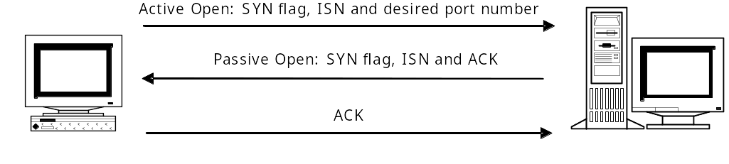
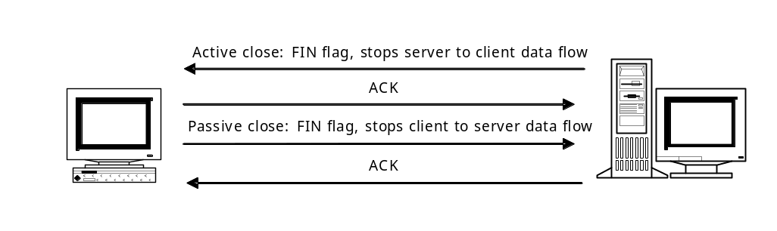
Protocol Overview
To understand many of the attacks described in this lesson, review the following protocol concepts
  The TCP initial handshake
  Terminating a TCP session

Slide 90
Protocol Overview
Internet Protocol (IP)
Internet Control Message Protocol (ICMP)
User Datagram Protocol (UDP)
Port numbers
Address Resolution Protocol (ARP)
Reverse Address Resolution Protocol (RARP)

Slide 91
Spoofing Attacks
Three types of spoofing
  IP spoofing
  ARP spoofing
  DNS spoofing
If you combine these spoofing types, you can spoof entire hosts and networks
Spoofing and traceback
Protecting against spoofing attacks

Slide 92
Scanning Attacks
Type
Description
Ping scan
A host directs a number of ping packets at a collection of hosts on a network. Used to determine the hosts that exist on a network.
Port scan
A host scans some or all of the TCP and UDP ports on a system to see which ports are open.
War dialing
A hacker uses software and a modem to discover hosts using modems to attach to the network.
War driving
A hacker uses a wireless NIC to see if a wireless network is in the area.
Network mapping
A hacker forges custom packets (ICMP, TCP or UDP) to scan and map networks. If the individual and/or application is clever enough, it is possible to map hosts inside of many network firewalls.

Slide 93
Scanning Attacks
Stack fingerprinting and operating system detection
Sequence prediction
Network Mapper (NMap)
Long-term scans
Fragmented ICMP packets and network scanning

Slide 94
Denial-of-Service (DOS) Attacks
The three main purposes of a denial-of-service attack are:
  To crash a server and make it unusable to everyone else
  To assume the identity of the system being crashed
  To install a Trojan or an entire root kit
Flooding
Malformed packets
  Teardrop/Teardrop2
  Ping of Death
  Land attack
  Miscellaneous attacks
Physical denial-of-service attacks

Slide 95
Distributed Denial-of-Service (DDOS) Attacks
A distributed denial-of-service (DDOS) attack involves several remote systems that cooperate to wage a coordinated attack that generates an overwhelming amount of network traffic
A DDOS attack involves the following components
  A controlling application
  An illicit service
  A zombie
  A target

Slide 96
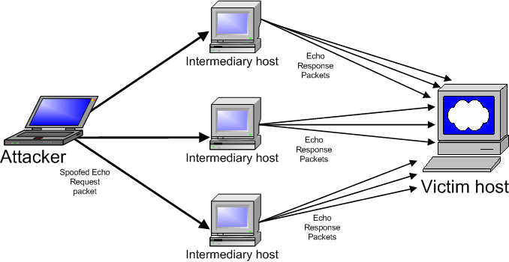
Distributed Denial-of-Service (DDOS)
Attacks (cont’d)
Smurf and Fraggle attacks
Protecting yourself against attacks

Slide 97
Distributed Denial-of-Service (DDOS)
Attacks (cont’d)
Ways to diagnose DOS and DDOS attacks
Mitigating vulnerability and risk

Slide 98
Man-in-the-Middle Attacks
Types
  Password sniffing
  Replay
  Connection termination
  Connection hijacking
  Packet insertion
  Poisoning
Conditions for man-in-the-middle attacks
Packet sniffing and network switches
Connection hijacking
DNS and ARP cache poisoning
Avoiding man-in-the-middle attacks

Slide 99
Profile of an Attack
The coursebook contains a description of a successful man-in-the-middle attack that involves:
  Scanning
  Sequence prediction
  Network sniffing
  Spoofing

Slide 100
Password-Guessing Attacks
Password guessing involves using various tools to discover a secret password.
Two techniques are used
  Brute-force attacks
  Dictionary attacks

Slide 101
Software Exploitation
It is possible to exploit software in two ways
  By attacking improperly coded software, creating a bug-based attack
  By exploiting an opening inadvertently created by a systems administrator, creating a configuration-related attack
Buffer overflow
Back doors
Errors in coding
Configuration-based attacks

Slide 102
Attacks Against Encryption
Although encryption is a powerful tool, it is not immune to attacks
Examples of attacks against encryption
  Weak keys
  Birthday attack
  Mathematical attacks

Slide 103
Social Engineering
The use of tricks and disinformation to gain access to passwords and other sensitive information
  Whereas systems consist of hardware and software, people are considered network "wetware”
  Social engineering could be called a wetware attack because it focuses on human weaknesses, not those found in network hosts
Common strategies to reduce the risk of social engineering
Components of a virus hoax

Slide 104
Malicious Code
Five types of malicious code are important to understand for the Security+ exam
  Viruses
  Worms
  Illicit servers
  Trojan horses
  Logic bombs
Repairing infected systems
Avoiding viruses, Trojans and root kits
Logic bombs and how to avoid them
Managing viruses, worms and illicit programs

Slide 105

Auditing
Auditing is the primary means of protecting yourself against malicious code
Examples of auditing
  Checking password databases regularly (e.g., the Windows SAM, and the UNIX /etc/passwd and /etc/shadow files)
  Identifying weaknesses in common Internet servers (relaying in a Sendmail SMTP gateway)
  Scanning systems for vulnerabilities
  Patrolling physical campuses for vulnerabilities
  Identifying areas of information leakage
    Necessary information
    Unnecessary information

Slide 106
Security+
Lesson 6
Operating System and Application Hardening

Slide 107
Lesson Objectives
Identify client-side issues related to managing e-mail, Web, instant messaging, database and file transfer applications
Identify specific ways to harden operating systems, including Windows 2003 and Linux
Harden individual applications (i.e., services), including Web, e-mail, news and DHCP

Slide 108
Security Baselines
Before you can effectively manage your network and its related systems, you need to create a security baseline
  This task is the first step to securing your network
You can conduct various types of baselines
  Network traffic
  System (e.g., e-mail or database server)
Purpose of a baseline

Slide 109
Client Security Issues
Although firewalls and intrusion-detection systems (IDSs) are obligatory in a large enterprise, nothing can compensate for improperly secured hosts and applications
Ways to secure clients
  End-user awareness training
  Become aware of client-side scripting vulnerabilities, including:
    JavaScript
    ActiveX
    Java

Slide 110
Client Security Issues (cont’d)
Controlling code: signing, sandboxing and updates
Cookies
Buffer overflows
Securing e-mail clients
  Spam
  Illicit content
  Viruses and worms
  Sniffing
  E-mail messages and MIME concerns
  Encryption and e-mail

Slide 111
Client Security Issues (cont’d)
Securing Web clients
Securing instant messaging and P2P applications
  File transfer and the 8.3 naming convention
  Additional attacks
  Securing P2P and instant messaging

Slide 112
Server-Side Issues: Application Hardening
When you work with individual services (applications), you must reduce risk by using the latest stable version of the service, and must limit unnecessary connections to it
Updates (hotfixes, service packs and patches)
  Update issues
  Uptime concerns
Encryption
  Secure Sockets Layer (SSL)
  Transport Layer Security (TLS)
Jails
Securing e-mail
  Relaying and spam
  Ways to control relaying

Slide 113
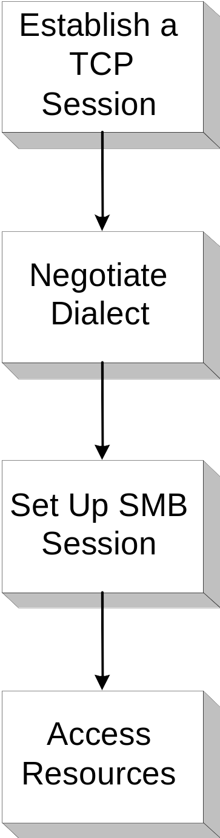
Server-Side Issues:
Application Hardening (cont’d)
File sharing and transfer
File sharing and print services
Server Message Block (SMB)

Slide 114
Server-Side Issues:
Application Hardening (cont’d)
File Transfer Protocol (FTP)
  Blind FTP
  Anonymous logon
  Limiting FTP access
  FTP Secure (FTPS): SSL-enabled FTP
  Secure Shell (SSH) FTP: S/FTP
Securing Web servers
  Common Gateway Interface (CGI) scripts
  CGI drawbacks
  Coding flaws, configuration issues, and ensuring quality CGI code
  HTTPS with SSL/TLS
  SHTTP
  Do not enable directly listing mode
  Limit connections

Slide 115
Server-Side Issues:
Application Hardening (cont’d)
Securing DNS servers
  DNS poisoning
  Illicit zone transfers
  Securing zone transfers
  Zone signing and public-key encryption
Additional servers

Slide 116

Operating System Hardening
It is not enough to secure the services (i.e., daemons). You must also secure the operating system running the services.
  Steps to take when securing systems
  Common services to disable by default
  Removing unnecessary services
  Examples
    TCP/IP filtering
    Internet Connection Firewall settings
    Configuring Syskey options
    Hiding the user last name
    Clearing the page file
    Interactive logon

Slide 117
Security+
Lesson 7
Securing Remote Access

Slide 118
Lesson Objectives
Define the functions of the Point-to-Point Tunneling Protocol (PPTP) and Layer 2 Transport Protocol (L2TP)
Configure a Virtual Private Network (VPN)
Compare Remote Authentication Dial-In User Service (RADIUS), Terminal Access Controller Access Control System (TACACS), TACACS+ and 802.1x
Define the purpose and function of IPsec
Identify common vulnerabilities in remote access systems
Distinguish between remote access and remote administration
Configure Secure Shell (SSH)

Slide 119
Remote Access Concepts and Terminology
Remote access is the ability for an organization to allow users to connect to its network
Many remote access methods are available
Remote access terms
  Connection medium
  Remote access server
  Perimeter
  Topology
  Router/switch
  Firewall

Slide 120
Overview of Remote Access Methods
Many methods exist
  Virtual Private Network (VPN)
  Terminal Access Controller Access Control System (TACACS) and TACACS+
  Remote Authentication Dial-In Use Service (RADIUS)
  IPsec
  802.1x
  Secure Shell (SSH)
    Not strictly a remote access method
    Can be used to encrypt protocols during a remote access session

Slide 121
Overview of Remote Access Methods (cont’d)
Authentication, authorization and accounting
When allowing remote access to a network, you must consider each of the following concepts
  Authentication
  Access control
  Accounting

Slide 122
Virtual Private Networks (VPNs)
A Virtual Private Network (VPN) is an encrypted tunnel that provides secure, dedicated access between two hosts across an unsecured network
Three types of VPNs
  Workstation to server
  Firewall to firewall
  Workstation to workstation

Slide 123
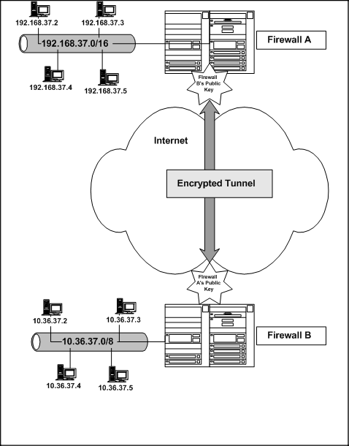
Virtual Private Networks (cont’d)
In firewall-to-firewall communication, hosts must exchange public keys

Slide 124
Virtual Private Networks (cont’d)
Tunneling
  Tunneling components
    Passenger protocol
    Encapsulation protocol
    Transport protocol
  Benefits of tunneling
Point-to-Point Tunneling Protocol (PPTP)
  PPTP vs. Point-to-Point Protocol (PPP)
  PPTP and Generic Routing Encapsulation (GRE) protocol
Layer 2 Tunneling Protocol (L2TP)
  L2TP elements
  Encryption and L2TP
VPN vulnerabilities
Comparing L2TP and PPTP

Slide 125
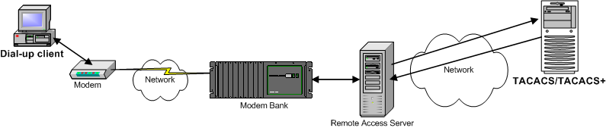
TACACS and TACACS+
Terminal Access Controller Access Control System (TACACS) and TACACS+
TACACS and TACACS+ vulnerabilities

Slide 126
Remote Authentication Dial-In User Service (RADIUS)
RADIUS is the most popular method for centralizing remote user access
Mostly meant for dial-up access
A RADIUS system can authenticate various connections across a public network
(e.g., modem, cable modem, DSL and wireless)

Slide 127
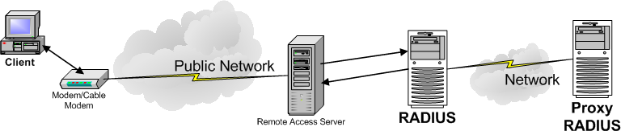
Remote Authentication Dial-In User Service (RADIUS) (cont’d)
RADIUS models
  Stand-alone
  Distributed
RADIUS terminology
RADIUS benefits
RADIUS vulnerabilities

Slide 128
IPsec
An IETF standard that provides packet-level encryption, authentication and integrity between firewalls or between hosts in a LAN
IPsec uses the following
  Authentication Header (AH)
  Encapsulating Security Payload (ESP)
Two IPsec modes
  Tunnel
  Transport
Security association (SA) and Internet Key Exchange (IKE)

Slide 129
IPsec (cont’d)
IPsec authentication options
IPsec vulnerabilities
Perfect Forward Security (PFS)

Slide 130
802.1x
Used in wireless networks to centralize authentication for wireless network clients
  Traditionally, a wireless client authenticates with a wireless access point (WAP), which is the wireless equivalent of a standard Ethernet hub or Layer 2 switch
  The 802.1x standard allows you to connect a WAP to a centralized server (e.g., a RADIUS server) so that all hosts are properly authenticated
802.1x authentication process
802.1x drawbacks and vulnerabilities

Slide 131
Remote Administration Methods
Remote administration involves the ability to control and configure a system or group of systems
Do not confuse remote administration with remote access, which is the ability to communicate with a remote network
Remote administration methods include Telnet, SNMP, SSH, terminal services, Virtual Network Computing (VNC), PC Anywhere and NetOP

Slide 132
Secure Shell (SSH)
Secure Shell (SSH) is a set of clients and servers designed to replace clients and servers that traditionally do not properly authenticate and encrypt network communications
Encrypts connections by default—hosts are authenticated
With additional configuration, can use public keys to authenticate user-based sessions
SSH components
  SSH: the command-line client, originally intended as a Telnet replacement
  SCP: a noninteractive method for copying files and/or directories between hosts
  SFTP: used as a secure replacement for unencrypted FTP

Slide 133
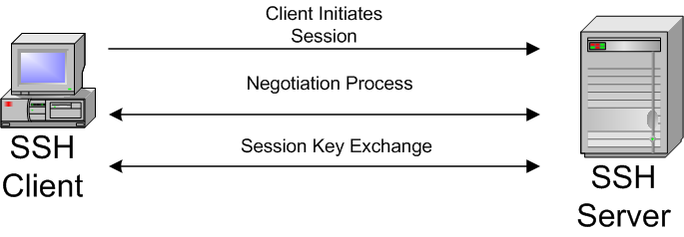
Secure Shell (SSH) (cont’d)
SSH and DNS
SSH architecture
Encryption and authentication in SSH
SSH host keys
Authentication methods (public key, keyboard interactive, password)

Slide 134
Secure Shell (SSH) (cont’d)
SSHv1 vs. SSHv2
  SSHv1 was the original protocol
  SSHv1’s encryption method has been cracked, and is vulnerable to sniffing attacks
  SSHv2 is the de-facto standard
SSH and port forwarding
  Used to tunnel normally unencrypted protocols
  Ideal for helping secure non-encrypted remote access sessions

Slide 135
Secure Shell (SSH) (cont’d)
SSH and public-key authentication
  You must generate your own key pair
  Public keys are then exchanged
  You configure your server or account to recognize your partner’s public key
  When users authenticate, the SSH server checks for a client’s public key; if the public key is available, the server will then check to see whether the requested account recognizes the key
  If the public key is recognized, authentication takes place without any passwords crossing the network
Automating authentication
SSH vulnerabilities

Slide 136
Security+
Lesson 8
Wireless Network Security

Slide 137
Lesson Objectives
Identify wireless network components and topologies
Define methods for securing wireless networks, including Wired Equivalent Privacy (WEP) and 802.1x
Define Wireless Transport Layer Security (WTLS)
Define the purpose of the Wireless Access Protocol (WAP)
Conduct site surveys to identify and correct common wireless networking vulnerabilities

Slide 138
Wireless Network Technologies
Wireless networks
  Popular
  Convenient
  Often improperly configured, used or placed on the network
Wireless networking media
  Direct Sequence Spread Spectrum (DSSS)
  Frequency Hopping Spread Spectrum (FHSS)

Slide 139
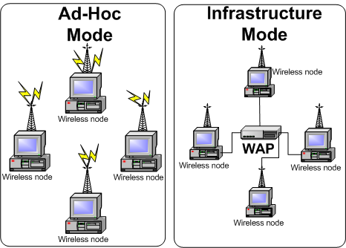
Wireless Network Technologies (cont’d)
Wireless networking modes

Slide 140
Wireless Network Technologies (cont’d)
Wireless access points (WAPs)
  Wireless cells
  Types of authentication in wireless networks
    Open System Authentication (OSA)
    Shared Key Authentication (SKA)
Basic Service Set Identifier (BSSID)
Service Set Identifier (SSID)
WAP beacon
Host association

Slide 141
Wireless Application Protocol (WAP)
Wireless Application Protocol (WAP) provides a uniform set of communication standards for cellular phones and other mobile wireless equipment
  Uniform scripting standards
  Uniform encryption standards, via the Wireless Transport Layer Security (WTLS) protocol
WTLS benefits
Languages used in WAP

Slide 142
Wireless Security Vulnerabilities
Wireless networks often suffer from the following problems
  Cleartext transmission
  Weak access control
  Unauthorized WAPs
  Weak and/or flawed encryption
  Slow traffic, due to encryption
  War driving

Slide 143
Wired Equivalent Privacy (WEP)
Wireless networks do not encrypt information by default
WEP encrypts all data packets sent between all wireless clients and the wireless access point (WAP)
Standard WEP encryption levels are 40 bits; however, many vendors now supply RC4-based 128-bit and 256-bit encryption
The 128-bit encryption is above standard, but is considered the acceptable minimum for business networks

Slide 144
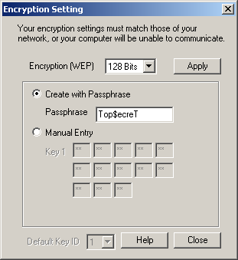
Wired Equivalent Privacy (WEP) (cont’d)
When using WEP, you can:
  Manually enter a WEP key
  Use a passphrase (as shown)

Slide 145

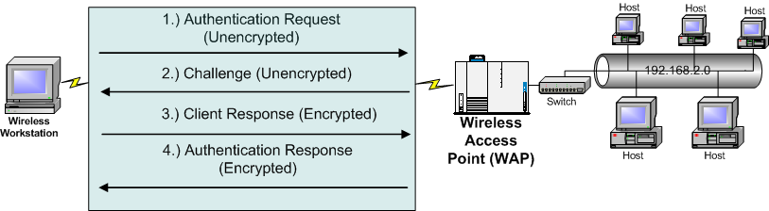
Wired Equivalent Privacy (WEP) (cont’d)
WEP problems and vulnerabilities
  WEP data encryption issues
Attacking the authentication sequence
  WEP data encryption issues

Slide 146
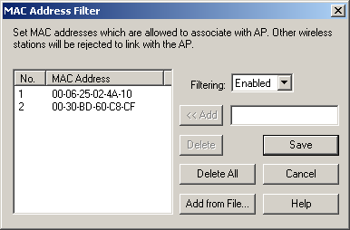
MAC Address Filtering
Where a WAP allows only certain MAC addresses
Policies
  Exclude all by default, then allow only listed clients
  Include all by default, then exclude listed clients

Slide 147
MAC Address Filtering (cont’d)
MAC address spoofing
Relatively trivial process

Slide 148
Problems with WTLS
Remember the following
  WTLS applies only to devices that use the Wireless Application Protocol (WAP)
  WTLS is not used for standard network connections (e.g., Ethernet connections)
  WEP is for Ethernet connections
“GAP in the WAP”
  When wireless information is placed onto a standard network via a gateway, it must be decrypted from WTLS then re-encrypted into standard PKI solution, such as SSL or TLS
  When WTLS traffic is first decrypted, it is possible to sniff connections and obtain sensitive information

Slide 149
Solutions for Wireless Network Vulnerabilities
Strong encryption
Strong authentication via 802.1x
Physical and configuration solutions

Slide 150
Site Surveys
Two types of site surveys
  Authorized
    Used to determine suitability of wireless networks
    Searches for sources of interference
    Audits for rogue wireless traffic
    Site surveys can occur before and after implementation
  Unauthorized
    War driving
    War walking

Slide 151
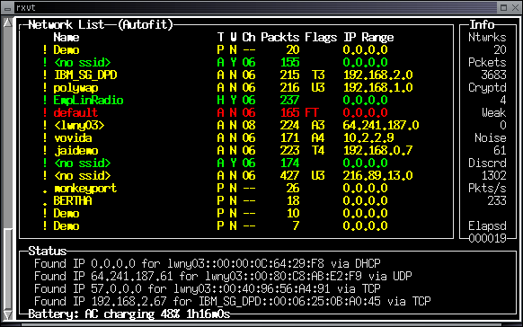
Unauthorized Site Surveys:
War Driving/War Walking
In war driving, an individual obtains wireless sniffing software, installs it (usually) on a notebook computer, and either drives (or walks) through areas where wireless networks are suspected to exist

Slide 152
Security+
Lesson 9
Security Topologies and Infrastructure Security

Slide 153
Lesson Objectives
Identify firewall security topologies and practices (e.g., DMZ, intranet, extranet, NAT)
Identify ways to harden networks
Identify security concerns for various media types, including coaxial, shielded twisted-pair and fiber-optic cable, and removable media
Identify security concerns for various devices, including firewalls, routers, switches, telecommunications equipment and VPNs
Apply physical security concepts to the network

Slide 154
Firewall Overview
In computer networking, a network firewall acts as a barrier against potential malicious activity, while still allowing a door for authorized users to communicate between your secured network and another network
Typical firewall functions
  Network perimeter establishment
  Traffic filtering
  Virus filtering
  Network Address Translation (NAT)
  Logging
  Tunneling
  Policy establishment

Slide 155
Security Topologies
After you have properly hardened the network, you can begin to allow selective access to it
  Allow selective access by creating a specific security zone, which is a specially designated grouping of services and computers

Slide 156
Types of Security Zones
A demilitarized zone (DMZ)
A service network
An intranet
An extranet

Slide 157
Creating a Virtual LAN (VLAN)
A virtual LAN (VLAN) is a logical grouping of hosts, made possible by a network switch and most newer routers
VLANs are useful in the following ways
  They improve security: you can isolate systems, for example, that are experiencing security problems
  They help improve performance
  They ease administration

Slide 158
Network Address Translation (NAT)
NAT is the practice of hiding internal IP addresses from the external network.
Three ways to provide true NAT
  Configure masquerading on a packet-filtering firewall
  Configure a circuit-level gateway
  Use a proxy server to conduct requests on behalf of internal hosts
RFC 1918 outlines the addresses that the IANA recommends using for internal address schemes
    10.0.0.0/8
    172.16.0.0/12
    192.168.0.0/16
  RFC 1918 addresses will never be routed over the Internet
  These addresses are internally routable, however

Slide 159
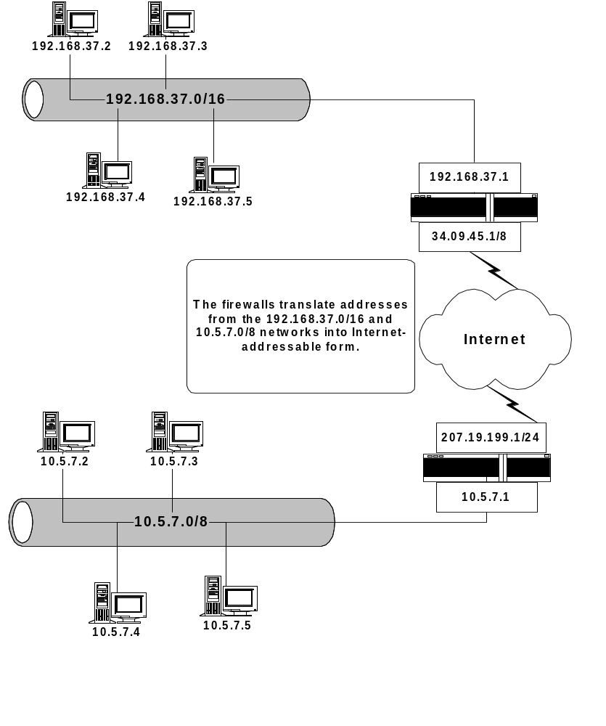
Network Address Translation (NAT) (cont’d)
NAT considerations
Masquerading
NAT benefits

Slide 160
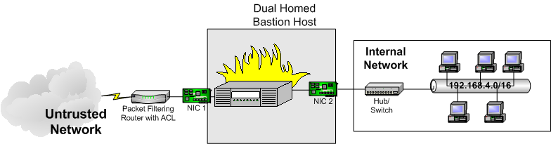
Types of Bastion Hosts
Dual-homed bastion hosts

Slide 161
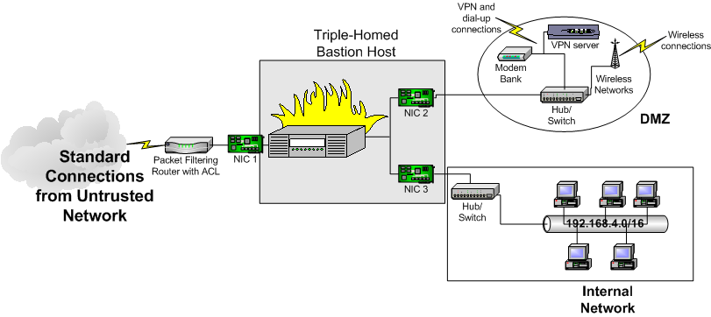
Types of Bastion Hosts (cont’d)
Triple-homed bastion host

Slide 162
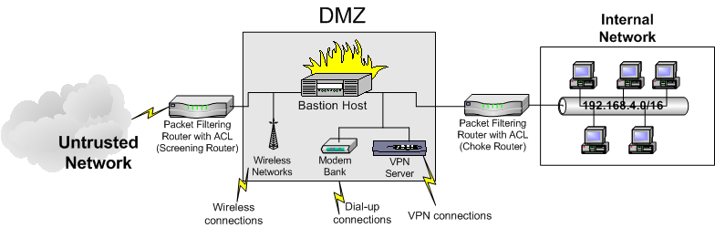
Types of Bastion Hosts (cont’d)
Alternative DMZ configuration
Internal firewalls

Slide 163
Traffic Control Methods
Packet filters
  Packet filter drawbacks
  Stateful multilayer inspection
  Popular packet-filtering products
Proxy servers
  Application-level proxy
  Circuit-level proxy
  Advantages and disadvantages of circuit-level proxies

Slide 164
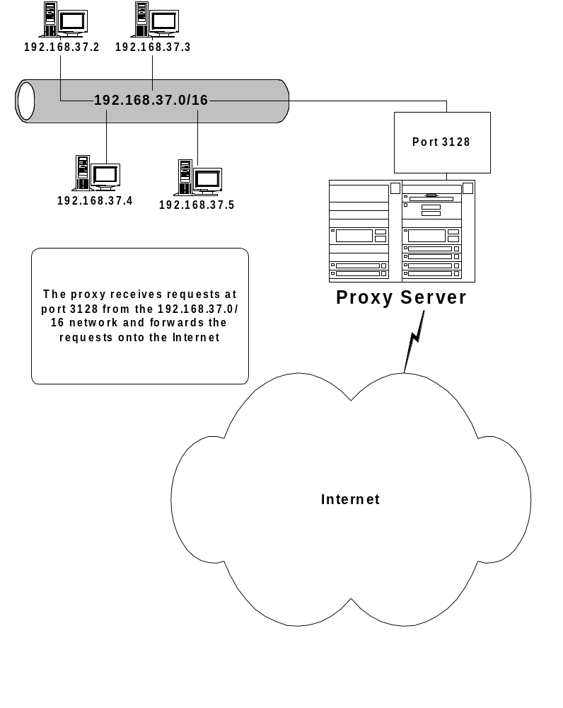
Traffic Control Methods (cont’d)
You must configure
a host to work with
a proxy server
The host's effective
IP address is
the same as
the proxy server

Slide 165
Traffic Control Methods (cont’d)
Recommending a proxy-oriented firewall
Proxy server advantages and features
  Authentication
  Logging and alarming
  Caching
  Fewer rules
Reverse proxies and proxy arrays (cascading proxies)
Proxy server drawbacks
  Client configuration
  Bandwidth issues

Slide 166
Configuring Firewalls
Default firewall stances
  Default open: Allows all traffic by default. You add rules to block certain types of traffic.
  Default closed: Allows no traffic at all by default. You add rules to allow only certain types of traffic.
Configuring an ACL
  Source address
  Source port
  Destination address
  Destination port
  Action

Slide 167
Network Hardening
Securing the perimeter
  Audit the modem bank
  Identify illicit wireless networks
  Make sure that VPN traffic goes through the firewall
Upgrading network operating system hardware, software and firmware
Enabling and disabling services and protocols
Improving router security
  Password-protect and authenticate automatic updates
  Obtain the latest operating system updates
  Consider the router’s susceptibility to denial-of-service attacks
  Disable unnecessary protocols
  Consider updates
  Restrict physical access to the router

Slide 168
Network Security Concerns
Network hosts
  Servers
  Workstations
  Mobile devices
Network connectivity devices
  Routers
  Switches
  WAPS and other wireless equipment
  Firewalls
Remote access devices
Convergence issues
Misuse of legitimate equipment

Slide 169
Physical Security Concerns
Your job as a security professional does not end with network security
Ensuring proper access to network resources also includes taking steps to physically secure your organization's buildings and all server rooms and wiring closets
Ensuring access control
Access control and social engineering
Physical barriers
Environmental changes
Location of wireless cells

Slide 170
Physical Security Concerns (cont’d)
Attacks, eavesdropping and shielding
  Radio frequency interference
  Electromagnetic interference
  Electromagnetic pulse (EMP)
  Crosstalk
  Attenuation
Shielding methods
  Transient Electromagnetic Pulse Emanation Standard (TEMPEST)
  Faraday cage

Slide 171
Physical Security Concerns (cont’d)
Securing removable media
  Tape drives
  Hard drives
  CD-R and CD-RW drives
  Additional USB and FireWire devices
  Smart card readers
  Additional media
Controlling environment
  Humidity controls
  Ventilation
  Power issues

Slide 172
Physical Security Concerns (cont’d)
Fire detection and suppression
  When securing equipment against fire, you need fire-detection equipment, as well as a way to suppress any fire that is detected
    Smoke detectors and air sniffers
    Flame and heat detectors
Fire suppression
  Wet pipe
  Dry pipe
  Chemical
    Halon
    Carbon dioxide
    FM-200 (Heptafluoropropane)
    IG-541 (Inergen)
    FE-13 (Trifluromethane)

Slide 173
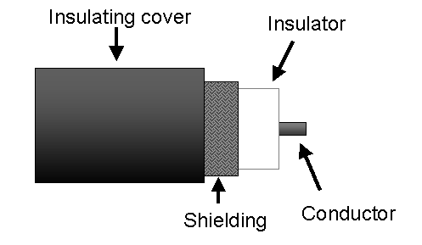
Cabling and Network Security
Coaxial cable
Common coax types (RG-8, RG-58)
Coaxial cable and termination
Security concerns for coaxial cable

Slide 174
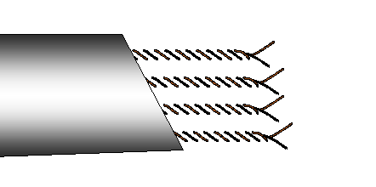
Twisted-Pair Cable
Has two or more paired wires
Two different types: shielded twisted pair and unshielded twisted pair
  Better topology
  UTP versus STP
  Twisted-pair ratings

Slide 175
Security Concerns for UTP/STP Cable
Plenum cabling
Interference
Crossover cables
Wiretapping

Slide 176
Fiber-Optic Cable
Made of a glass or plastic cylinder enclosed in a tube, called cladding
An insulating sheath covers the core and cladding
Two modes
  Single-mode
  Multimode
Connector types
Benefits of fiber-optic cable
  Resistant to EMI and RFI
  Resistant to wiretapping
Drawbacks of fiber-optic cable

Slide 177
Protecting the Network
Against Common Physical Attacks
Consider the following issues
  False ceilings
  Exposed communication lines
  Exposed jacks
  Exposed heating/cooling ducts
  Doors with exposed hinges
  Inadequate lighting
  Lack of surveillance
  Poor lock quality
Not even a high-quality password can thwart certain physical attacks

Slide 178
Security+
Lesson 10
Risk Analysis, Intrusion Detection and Business Continuity

Slide 179
Lesson Objectives
Define risk identification concepts
Distinguish between types of intrusion detection
Identify the purpose and usefulness of a honey pot
Implement an incident response policy
Identify key forensics issues, including chain of custody, collection of evidence and preservation of evidence
Determine disaster recovery steps
Distinguish between disaster recovery and business continuity

Slide 180
Risk Identification
A risk assessment allows you to locate resources and determine the likelihood of a successful attack
Sometimes called a “gap analysis”
Consider the following terms
  Threat
  Vulnerability
  Risk
  Return on investment

Slide 181
Risk Assessment Steps
Asset identification
  Consider business concerns
  Consider potential for internal and external attacks
Threat identification
  Common techniques used in man-made attacks
Identifying and eliminating vulnerabilities: risk assessment
  Vulnerability scanners
  Updates
  Penetration-testing tools
  Managing the process of eliminating vulnerabilities

Slide 182
Risk Assessment Steps
System configuration monitoring tools
Calculating loss expectancy
  Determining specific losses for your risk assessment
Justifying cost

Slide 183
Intrusion Detection
Basic definition
  The real-time monitoring of network activity behind the firewall
  Detects and logs network and/or host-based traffic
Intrusion-detection strategies
  Signature detection
  Anomaly detection
Typical actions taken by an IDS
IDS application types
  Host-based
  Network-based

Slide 184
Network-Based Intrusion Detection
Used to identify traffic on the network
A network-based IDS scans the entire network, then issues alerts when certain thresholds are exceeded
  Passive detection versus active detection
  Benefits and drawbacks
  Switched networks and network-based IDS applications

Slide 185
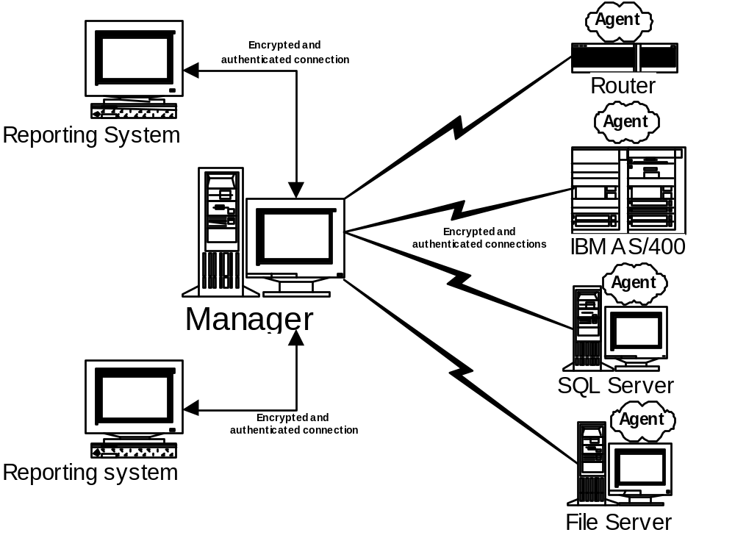
Host-Based Intrusion Detection
Management structure

Slide 186
Host-Based Intrusion Detection (cont’d)
Consider the following
  Active versus passive host-based IDS
  Manager-to-agent communication
  Strengths and limitations of host-based IDS applications
  Monitoring specific services

Slide 187
IDS Signatures and Rules
As with antivirus applications and vulnerability scanners, an IDS application requires a current signature database
Both network and host-based IDS applications use a signature database
  Rules
  Actions
Securing intrusion-detection devices and applications
  Harden the IDS application and/or the operating system
  Physically secure the system

Slide 188
Choosing the Correct IDS
Each type of IDS application has its own place
Problem
Ideal IDS Choice
DOS attacks involving traffic floods emanating from the internal network
Network-based IDS.
Brute-force attacks on an e-mail server account.
Both a network-based and host-based IDS will work. However, a host-based IDS will give you more granular information about a specific e-mail server.
NICs in promiscuous mode
Network-based IDS.
Presence of illicit servers
Network-based IDS.

Slide 189
False Positives and False Negatives
A false positive occurs when the IDS mistakes legitimate traffic for illegitimate traffic
  Caused by old signature databases
  Caused by low thresholds
A false negative is whenever an IDS does not detect an intrusion, even though one is occurring
  Causes
    The IDS is on a switched network
    Improper configuration
    DOS/DDOS attacks meant to mask other illegitimate traffic
    Encrypted traffic

Slide 190
IDS Software
Computer Associates eTrust Intrusion Detection, formerly SessionWall (www.my-etrust.com)
Snort (www.snort.org)
Intruder Alert (www.symantec.com)
ISS RealSecure (www.iss.net)
Network Flight Recorder (www.nfr.com)

Slide 191
Honey Pots
An attractive target placed in open view of attackers
Intended to divert the attention of a hacker from your system's resources and allow for alerting
In most cases, the best location for a honey pot is in the DMZ, where it can be used to distract hackers from real resources
Often, a honey pot will spoof ARP requests to imitate multiple hosts
Honeypot components

Slide 192
Elements of an Incident Response Policy
Description of the incident response team
Description of specific actions to take
Clear chain of authority
  Designate a leader of your incident response team
  Document the reporting structure
  Educate all concerned parties about your reporting structure
  Need to know
Documentation
The aftermath: identifying and correcting issues

Slide 193
Forensics
Collecting evidence
  Evidence storage
  Methods for collecting information
    Creating images of hard drives
    Documenting connections made to the system using applications such as netstat, nbtstat, smbstatus and lsof
    Obtaining a list of processes running on the system
    Creating screen captures of the system to prove the existence of an attack or evidence of damage
    Determining files that have been deleted, and recreating them if possible

Slide 194
Forensics (cont’d)
Chain of custody
  Be able to answer the following questions
    Where was this evidence stored?
    Who handled the evidence after it was stored?
    Who guarded the evidence?
    How was the evidence secured from tampering?
  Preservation of evidence
Using forensic evidence
  Internal litigants
  Law enforcement
  Insurance companies
Forensic tools

Slide 195
Disaster Recovery
Basic definition
  Disaster recovery focuses on creating plans that allow you to recover from short-term, catastrophic problems and return business to normal
Creating a disaster recovery plan
  Business impact analysis (BIA)
  Maximum tolerable downtime (MTD)
  Backups and disaster recovery: off-site storage
    Transportation security
    Off-site storage security
  Secure recovery: alternative sites
    Hot, warm and cold sites

Slide 196
Business Continuity
Basic definition
  Takes a more holistic approach than disaster recovery, which means that it focuses on returning the entire business to normal operations
  You cope with long-term business operation concerns
Utilities

Slide 197
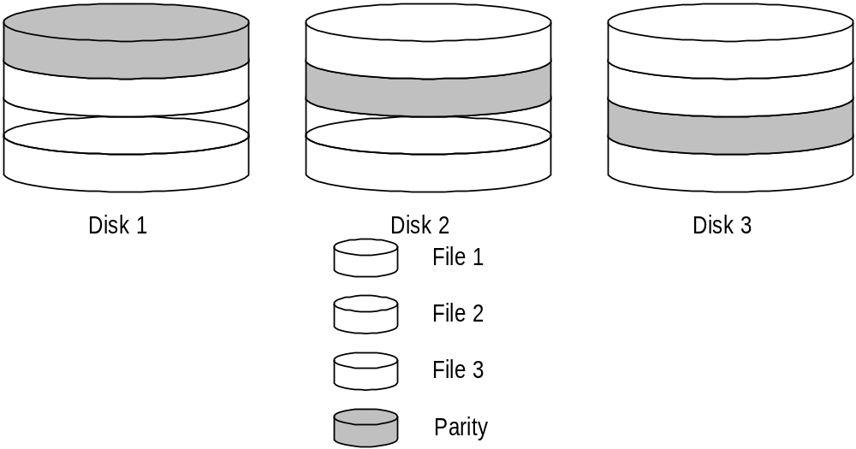
Business Continuity (cont’d)
High-availability and fault tolerance
  Create redundant sites
  Configure individual systems so that they have redundant sub-elements
    RAID (e.g., RAID 5 shown below)

Slide 198
Backups and Business Continuity
RAID provides fault tolerance and redundancy. It does not provide a dedicated data backup service. For the Security+ exam, you will need to understand the following backup methods
  Full backup
  Differential backup
  Incremental backup
Media reuse and backup methods
Benefits and drawbacks of full, differential and incremental backups

Slide 199
Backup Strategies
Understand the following strategies
  Full backup nightly
  Full and differential backups
  Full and incremental backups
  Father/son/grandfather
Backup verification
  An unverified backup is almost the same as having no backup at all
  Consider the following strategies
    Verifying archive existence
    Listing contents of the archive
    Performing a test backup
    Verifying archive integrity (e.g., using MD5sum)

Slide 200
Backup strategies (cont’d)
Backup storage issues
  Sunlight
  Excessive heat or cold
  Improper humidity
  Magnetic fields
Backup and encryption

Slide 201
Security+
Lesson 11
Security Policy Management

Slide 202
Lesson Objectives
Define components of a security policy, including acceptable use and HR policy
Define privilege management concepts
Train company employees to work securely
Document company and network security plans

Slide 203
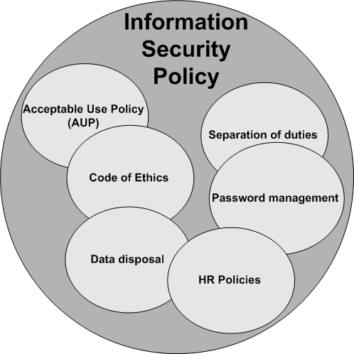
Security Policy
Security policy elements

Slide 204
Security Policy (cont’d)
Need to know
Acceptable use and code of ethics
  Addresses the ways that employees can use equipment and services provided by the company
  Publicizing the policy
Due care versus due diligence
Separation of duties
  IT workers should not be responsible for securing the services they provide. It can be a direct conflict of interest.
Password management

Slide 205
Security Policy (cont’d)
Vendor relations
  Workers may leave the company with vital information
  Document all contacts
  The Service Level Agreement (SLA)
  Store all SLAs for later reference
Sensitive data disposal
  Hard copy
  Servers and workstations
  Network connectivity equipment
  Destroying logs

Slide 206
Human Resources Policies
Hiring
  Consider the following hiring procedures
    Orientation
    Informing IT
    Assigning user permissions
    Verifying correct privileges
    Emphasize the creation of specific procedures and policies to new hires
Termination
  Revoking user rights
  Conducting exit interviews
  Forcibly logging off terminated user(s)
  Providing an escort for the user, if necessary

Slide 207
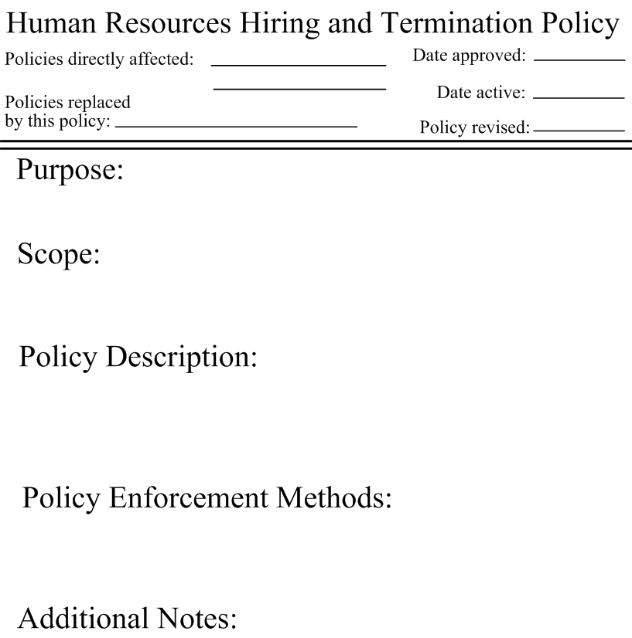
Writing a Specific Policy
The following elements are commonly found
  Policy name
  Approval date
  Active date
  Policies replaced
  Policies directly affected
  Scope
  Purpose
  Additional notes
  Responsible individuals

Slide 208
Privilege Management
Issues to consider
  Users, groups and roles
  Single sign-on
  Centralized versus decentralized
  MAC/DAC/RBAC issues
Privilege auditing, network use and improper escalation

Slide 209
Training Secure Practices
Education
  Awareness training
  Communication and escalation training
  Software education
  IT training
Opportunities for education
Information resources
  Hard copy
  Online
    Sample resources

Slide 210
Documentation
IT standards and guidelines
  Examples
    Operating system installation
    Equipment replacement
    Software updates
    Auditing
    Additional policies exist
Documenting systems architecture
  Documenting network architecture
  Logs and inventories
Keeping logs
  Log size
  Impact of logging

Slide 211
Classification and Notification
Classification levels: Unclassified, Confidential, Secret and Top Secret
  Ensure that all documents notify readers about their classification level
  Document that all employees are aware of their current security level
Change management
  Change documentation and compliance
  Change-management issues

Slide 212
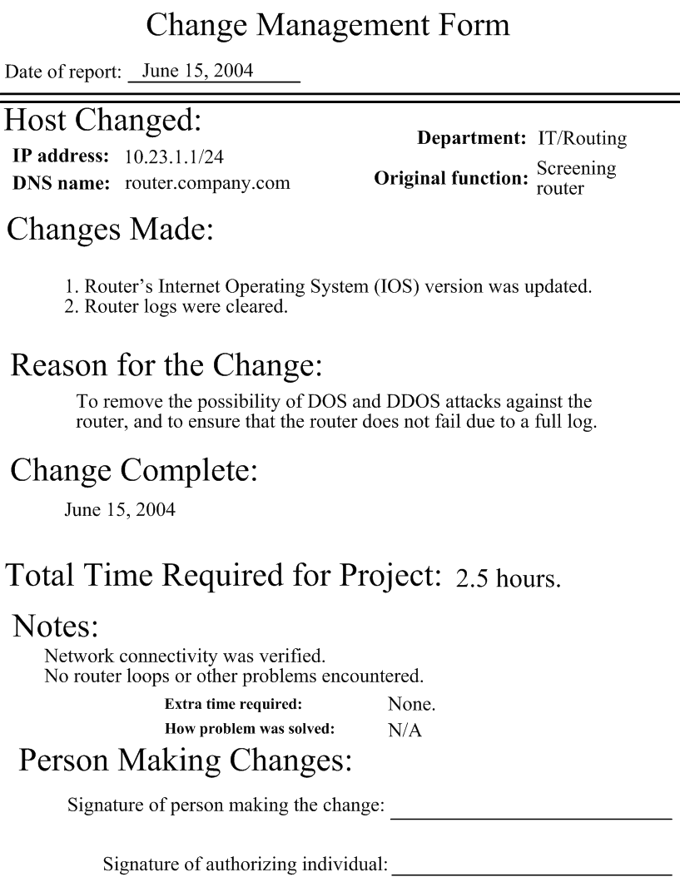
Classification and Notification (cont’d)
Creating change documentation
Documents can
include various
elements, including
a description of
the host, the reason
for the change, and
detailed information
about the change
itself

Slide 213
Retention and Storage Issues
Documentation will accrue through time. You eventually must answer the following questions, so write them into your security policy.
  How long should old network documentation (e.g., network maps) be stored?
  When should procedures documents be revised?
  How should the department dispose of old documents?

